Slide 1
Application Layer : DNS
Prepared By: Ms. Vidhi Pandya

Slide 2
Learning objectives
To understand need of DNS – Domain Name System
To understand the concept of Domain Name Space
To understand working of Domain Name Server

Slide 3
DNS – Domain name system
Network understands only numerical addresses
Difficult to remember network address
ISP/organization moves server, need to update network address
Need
File – host name with IP address
Fetch the data from the file
Day by day size of file increase as per the no of user increases
Become not feasible solution to maintain a file – invention of DNS
History

Slide 4
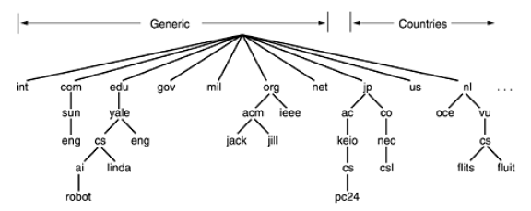
Domain name space
Structure : Tree
Domains : Top level Domain, Sub Domain, Sub Subdomain so on….
Components : Separated by dots (periods)
Example : cn.depstar.charusat.edu

Slide 5
Continue …..
Domain Name
Absolute
Relative
Always ends with a period
Always ends with a component
Domain Name : Case insensitive (edu, EDU, Edu – all same)
Length of Component name : 63 characters
Length of Full path : 255 characters

Slide 6
Domain resource records
Primary function of DNS – map domain name with record
Resource record is 5 tuple – encoded in binary
Domain Name
TTL
Class
Type
Value
Primary Key
Tells name of domain
TimeToLive
Indicate stability of record
Internet Information – IN
Non internet information
Type of record
Depends on type of record

Slide 7
Continue …..
Type | Meaning | Value
SOA | Start of Authority | Parameters for this zone
A | IP address of host | 32 bit integer
MX | Mail Exchange | Priority, Domain willing to accept e-mail
NS | Name Server | Name of server for this domain
CNAME | Canonical Name | Domain Name
PTR | Pointer | Alias for an IP address
HINFO | Host Description | CPU & OS in ASCII
TXT | Text | Uninterpreted ASCII text

Slide 8
Domain name servers
Get overloaded
Down
Server failure
Issue with
Single Server
Two types of query method:
Recursive Query – Full answer
Iterative Query – Partial answer

Slide 9


Continue …..
Query : computer networks.cs.depstar.charusat.edu
edu Server
Computer networks.cs.depstar.charusat
charusat.edu
Computer networks.cs.depstar
charusat Server
Query
depstar.charusat.edu
Response
Computer networks.cs
depstar Server
Organization / User
Local Server
cs.depstar.charusat.edu
Computer networks
cs Server
Computer networks.cs.depstar.charusat.edu

Slide 10
Reference Book: Computer Networks 4th edition Andrew s. tanenbaum

